Slide 1
Children transportation company funding
Name
Institutional Affiliation
Course
Date

Slide 2
Table of content
Executive summary
Information about the company
Marketing plan
Competitor analysis
Income statement
Profit projections
Major assumptions for expenses, sales growth and investment
Funding schedule
Break even analysis
Expansion of the company
Notes:
Welcome to my presentation. This presentation will focus on several areas concerning the project for Children transportation company funding. I will be focusing on the following aspects:
Executive summary
Information about the company
Marketing plan
Competitor analysis
Income statement
Profit projections
Major assumptions for expenses, sales growth and investment
Funding schedule
Break even analysis
Expansion of the company

Slide 3
Executive summary
For the children’s transportation to be established the $500,000 need to be raised for its initial funding.
The presentation is about the marketing plan, an estimate of financial projection as well as an estimation of three year income statement.
Assumptions for the sales growth as well as what expenses and investment cost will be incurred for achieving revenue goals.
The funding schedule for sources and the use of funds received and breakeven for the company and expansion of the company.
Advantages and disadvantages of the using debts financing versus raising capital by selling company’s stock have been addressed including process of capital.
Notes:
This is a slide presentation for children’s transportation company to be established and requiring around $500,000 to be raised for its initial funding.
The presentation will be based on the marketing plan, an estimate of financial projection as well as an estimation of three year income statement.
There are some assumptions that will be considered in this project on the sales growth as well as what expenses and investment cost will be incurred for achieving revenue goals. The funding schedule will be used to show the sources and the use of funds received. The breakeven will be used to show what amount of sales will be needed to reach the expected amount of revenue. The presentation has focused more on the expanding the children’s transportation company internationally which will have some implication to investors decisions. Besides, advantages and disadvantages of the using debts financing versus raising capital by selling company’s stock have been addressed. Further, the process of capital venture has been discussed in this presentation.

Slide 4
Information about the industry
The children’s distribution company entails a firm for picking up a large number of children and taking them to and from school
It will also take children for games.
To offer safe and licensed transport services to pupils and students
It has reliable and safe vehicles that meets every safety requirement.
The estimate start up cost is $500,000
The company has considerable designs of vehicles
Drivers with clean licenses.
The budget for ongoing cost of vehicle include the expenses of fueling, maintenance and consistent leaning of the vehicles
The company has insurance covers for all the vehicles.
The assistant drivers and receptionist will perform different duties
Notes:
This is description of the company’s information:
The children’s distribution company entails picking up a large number of children and taking them to and school
It will also take children for games.
To offer safe and licensed transport services to pupils and students
It has reliable and safe vehicles that meets every safety requirement.
The estimate start up cost is $500,000
The company has considerable designs of vehicles
Drivers with clean licenses.
The budget for ongoing cost of vehicle include the expenses of fueling, maintenance and consistent leaning of the vehicles
The company has insurance covers for all the vehicles.
The assistant drivers and receptionist will perform different duties.

Slide 5
Children’s transportation company marketing plan
Situational analysis: Offering transport services by picking up children to school and game activities
Objectives: Offering transport services by use of vehicles such as buses and small vans.
Marketing strategies: Extensive advertising on the new services provision in marginalized areas
Action plan: to achieve the stated objective, the company is striving to offer unique services.
Financial analysis: we are expecting $150,000 and project the breakeven for this project within the first two years.
Contingency plans: in the event of increased competition through advertising, the company will add $50,000 for adverting budget.
Notes:
This slide show the analysis of the children’s transportation company marketing plan.
Situational analysis: Offering distribution services in our primary market
Objectives: Offering transport by use of vehicles such as cars, Uber, busses, lorries and transit.
Marketing strategies: Extensive advertising on the new services provision in marginalized areas
Action plan: to achieve the stated objective, the company is striving to offer unique services.
Financial analysis: we are expecting $150,000 and project the breakeven for this project within the first two years.
Contingency plans: in the event of increased competition through advertising, the company will add $50,000 for adverting budget.

Slide 6
Children’s transportation company marketing plan
SWOT Analysis of Children’s transportation company
Strength: It is ideal for at-home parents
Weakness: High cost of insurance that may be hard to pay
Opportunities: The company is completely expandable
Threats: Stiff competition due to increasingly high number of schools with school buses
Notes:
SWOT Analysis of Children’s transportation company
Strength: It is ideal for at-home parents
Weakness: High cost of insurance that may be hard to pay
Opportunities: The company is completely expandable
Threats: Stiff competition due to increasingly high number of schools with school buses

Slide 7
The competitor analysis
Kids Kruiser is the children’s transportation company rival.
competitor SWOT analysis:
Strengths: experienced drivers with over 15 years of experience
Weaknesses: The use of taxi and inability to expand Kids Kruiser are the major threats.
Opportunities: Ability to interact with children and build strong relationship with them
Threats: Limited number of kids in need of transport services

Slide 8
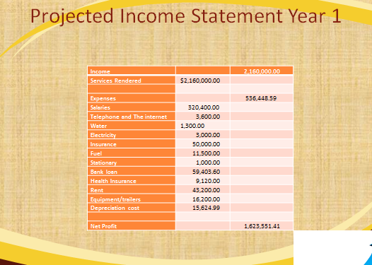
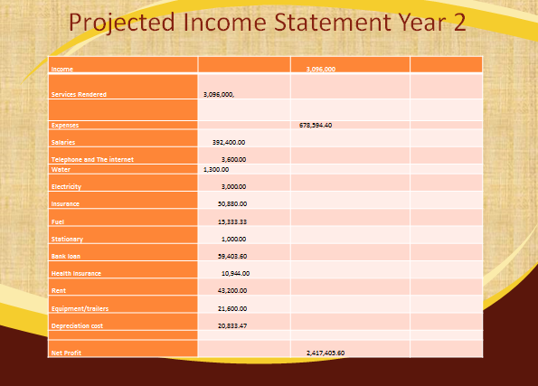
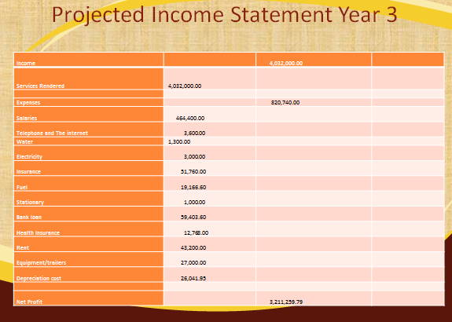
Income statement for 1st 2nd and 3rd year

Slide 9
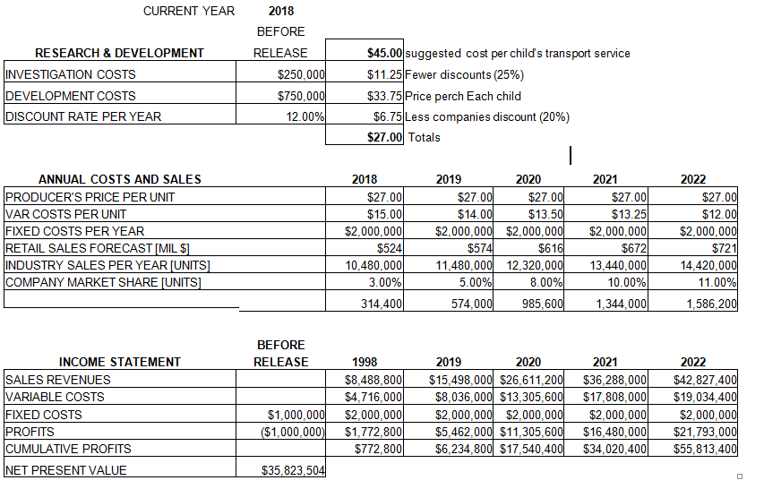
Financial projected
Research and development is expected to cost around $1000,000 at the end of this year
Annual costs are expected to increase after every year
It is projected that by after three years (2019-2021), the cumulative profit will amount to $34,540,400.
The assumptions for sale growth and investment are that :
There is limited number of school with school bus
Minimal government intervention
High qualified staff
No other convenient means of transport.
Notes:
This slides shows the financial projection based on the income statement.
According to this slide, Research and development is expected to cost around $1000,000 at the end of this year
Annual costs are expected to increase after every year
It is projected that by after three years (2019-2021), the cumulative profit will amount to $34,540,400. The assumptions for sale growth and investment are that :
There is limited number of school with school bus
Minimal government intervention
High qualified staff
No other convenient means of transport

Slide 10
Sources and use of fund
Date | Source of fund | Use
January 21st 2019 | Well-wishers and volunteer $750,00 | Project development and research
June 28th 2019 | Donation from individual and government | Initial building and construction cost
October 20th 2019 | Loan from World bank $250,000 | Project investigation
July 25th 2019 | Finance from donors | Growth of sales and investment
Notes:
January 21^{st 2019} the company expect to get funds from Well-wishers and volunteer
$750,00 which will be used for Project development and research
June 28th 2019 expects Donation from individual and government for Initial building and construction cost
October 20th 2019 the company expects $250,000 World bank for Project investigation
July 25th 2019 will expects Finance from donors for Growth of sales and investment

Slide 11
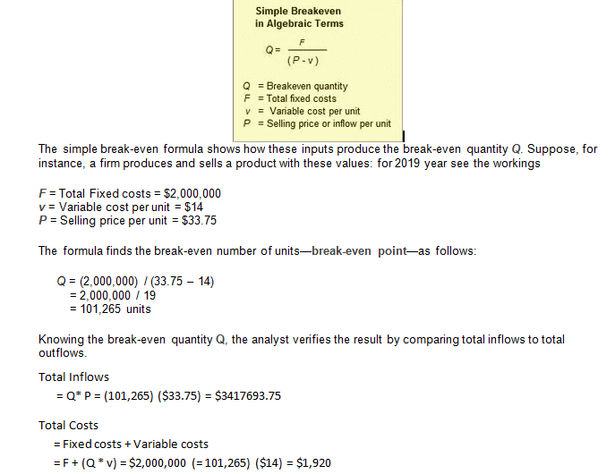
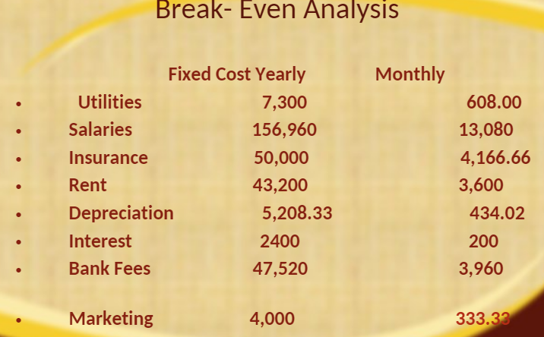
Break-Even Analysis
This is break even-even for the children’s transportation company
The total fixed (f) cost is $2,000,000
The variable cost per unit is $14
And the selling price per unit is $33.75
Notes:
This slides discuses something to do with Children’s transportation company break-even.
This is break even-even for the children’s transportation company
The total fixed (f) cost is $2,000,000
The variable cost per unit is $14
And the selling price per unit is $33.75

Slide 12
Expansion of the company by 3 investors
The countries that I would wish to expand include china and Mexico
Reasons as to why I want to invest in these countries first is to;
Enjoy Providing our Drivers with Jobs
•Job Security and Opportunity of Financial Increase
Remaining Current and Establish new market for the company
Exposing business to a wider market
To improve sales and profitability
Outsourcing labor
The factors that I will consider when making this decision include:
Competition level
The government policy
Regulation requirement in those countries
Notes:
This slides focuses on the reasons and factors to consider expanding children's transportation company in china and India The countries that I would wish to expand include china and India.
Reasons as to why I want to invest in these countries first is to
Establish new market for the company
Exposing business to a wider market
To improve sales and profitability
Outsourcing labor
The factors that I will consider when making this decision include:
Competition level
The government policy
Regulation requirement in those countries

Slide 13
Corporate tax for china and Mexico
The corporate tax for china stands at 25 percent.
This rate (25%) is a standard tax rate and is likely to be reduced to 15% for only those qualified companies.
Mexico has corporate tax rate of 22% which is the flat rate for many companies for residential firms and 30% for non-residential firms.
The increased corporate tax in china from 25% upwards it will means that there is reduced company’s propensity to invest.
The reduced corporation tax to like 15% it will m make the company to increase its propensity to invest leading to business friendly environment globally.
Notes:
This slide describes corporate tax rate for china and Mexico
The corporate tax rate for china stands at 25 percent.
This rate (25%) is a standard tax rate and is likely to be reduced to 15% for only those qualified companies.
India has corporate tax rate of 25% which is the flat rate for many companies
The increased corporate tax in china and Mexico from 25% upwards it will means that there is reduced company’s propensity to invest.
The reduced corporation tax to like 15% it will m make the company to increase its propensity to invest leading to business friendly environment globally.

Slide 14
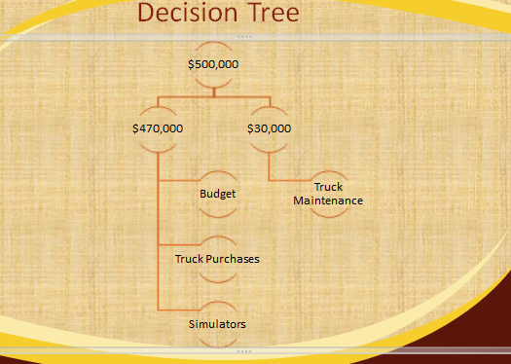
Decision tree
Notes:
This slide is a description of decision tree detailing the decisions you would make if you received $300K now and $200K at the end of three years instead of $500K up front.
The additional loan disperse will be after year 4 the company will purchase trailers saving the company 22,000 per year in Rental. The company will two simulators that will enhance the training experience form drivers
The $250,000 loan is additional fund
Utilized to buy 6 buses at $20,000 per
The $50,000 will be used to purchase two simulators each
The $6,000 per tractor will be Maintenance Cost on Vehicles

Slide 15
Advantages: Using Debt Financing vs. Selling Company Stock
Helps in retaining Control
Has tax Advantage
Debt Financing has Simple Obligation
Easier Planning than Selling Company Stock
Notes:
Using Debt Financing is more advantageous that Selling Company Stock
Helps in retaining Control
Has tax Advantage
Debt Financing has Simple Obligation
Easier Planning than Selling Company Stock

Slide 16
Disadvantages: Using Debt Financing vs. Selling Company Stock
Disadvantages of using Debt Financing vs. Selling Company Stock include:
High interest rate
High debt exposure can stunt growth
Repayment
Collateral
Fixed payment terms
Qualification requirement
Notes:
Disadvantages of using Debt Financing vs. Selling Company Stock include:
High interest rate
High debt exposure can stunt growth
Repayment
Collateral
Fixed payment terms
Qualification requirement

Slide 17
Venture Capital Process
The Criteria for Investment
  Seed
Strategy for Investment
  Early Stage
Sourcing Deal
  Formative Stage
Finalizing the Process
  Later Stage
Venture Fund Structure
  Balancing Stage
Notes:
The source of financing for new businesses is what we call Venture Capital is. It pool investors' fund to startup firms.
It’s important to understand the criteria of the investment meaning the ends and outs of the process and generally speaking how the funds will come about.
The way the funds are stretched turns into good idea for incorporating venture capita process, generating more income using international services of our company. Usually the Venture Capital Process Make sense for children’s transportation company

Slide 18
References
Nachum, L. (1998). Danish professional service firms: Why are they not competitive internationally? A comparative analysis between Danish and UK management consulting firms. Scandinavian journal of management, 14(1-2), 37-51.
Ross, S., Westerfield, R., Jaffe, J. & Jordan, B. (2016). Corporate finance (11th edition). New York, N.Y. McGraw-Hill Education.
University of Phoenix. (2016). OECD Tax Database. Retrieved from University of Phoenix, FIN571 website.

